Slide 1
BCT 2310: Automata theory
Lecturer: Mrs. Martha Gichuki
Email ID: mgichuki@jkuat.ac.ke

Slide 2
Logic & Truth Tables
A computer may be programmed to make decisions based on whether certain statements.
Example: “The number just computed exceeds 100” are true or false.
The truth or falsity of a statement is called its truth value.
A statement is either true or false but not both.

Slide 3
Some statements are compound statements; meaning, they are composed of sub-statements and various connectives.
For example, “He is intelligent or studies very hard” is an implicit statement. A compound statement and sub-statements would be; “He is intelligent” and “He studies very hard”
The fundamental property of a compound statement is that its truth value is completely determined by the truth values of its sub-statements together with the way in which they are connected to form the compound statement.

Slide 4
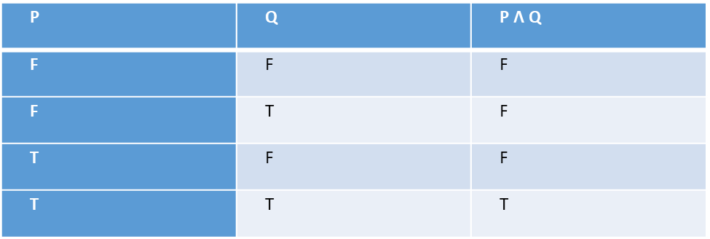
Various connectives are used to connect statements. These are:-
(i.) Conjunction (P Λ Q)
Any two statements can be combined by the word “and” to form a compound statement called the conjunction of the original statement symbolically written as P Λ Q; Which denotes the conjunction of the statements P and Q read as “P and Q”.
The truth values of the compound statement P Λ Q is given by the truth table: -

Slide 5
Here, the last line is a short way of saying that if P is true and If Q is True, then P Λ Q is also true. The other lines have analogous meaning. We regard this table as defining precisely the truth values of the compound statement P Λ Q as a function of the truth values of P and Q.

Slide 6
Consider the following statements which are represented in form of a truth table below: - i). Paris is in France and 2 + 2 = 4 ii). Paris is in France and 2 + 2 = 5 iii). Paris is in England and 2 + 2 = 4 iv). Paris is in England and 2 + 2 =5
P | Q | P Λ Q
T | T | T
T | F | F
F | T | F
F | F | F

Slide 7
(ii.) Disjunction (P V Q) Any two statements can be combined by the word “or” to form a new statement which is called the disjunction of the original two statements, symbolically written as P V Q. This denotes the disjunction of the statements P and Q which is read as “P or Q”. P V Q is false only when both statements are false. The truth values of P V Q are given by the truth table: -
P | Q | P V Q
T | T | T
T | F | T
F | T | T
F | F | F

Slide 8
(iii.) Negation (~P) Given any statement P, another statement known as the negation of P can be formed by writing “It is false that…” before P or if possible, by inserting in front of P the word “not”; symbolically written as “∼P”. This denotes the negation of P read as “not P”. If P is true, then ∼P is false. Thus the truth value of the negation of any statement is always the opposite of the truth value of the original statement. The truth values of ∼P are given by the following table: -
P | ∼P
T | F
F | T

Slide 9
Propositions & Truth Tables
By repetitive use of the logical connectives - Λ, V, ∼ and others, we can construct a compound statement(s) that are more involving.
In the case where the sub-statements P, Q of compound statements P (P, Q …) are variables; we call the compound statement a proposition.
The truth value of a proposition depends exclusively upon the truth values of its variables.
That is, the truth value of a proposition is known once the truth values of its variables are known.

Slide 10
A simple way to show its relationship is through a truth table. The truth table of the proposition ∼(P Λ ∼Q), for example is constructed as follows: -
P | Q | ∼Q | P Λ ∼Q | ∼(P Λ ∼Q)
T | T | F | F | T
T | F | T | T | F
F | T | F | F | T
F | F | T | F | T

Slide 11
Tautologies & Contradictions
Some propositions contain only T in the last column of their truth tables i.e. are true for any truth values of their variables.
Such propositions are called tautologies.
Similarly, a proposition P (P, Q …) is called a contradiction if it contains only F in the final column of its truth table i.e. is false for any truth values of its variables.
For example, the proposition “P and not P” (P Λ ∼ P) is a contradiction. This is verified by constructing their truth tables as follows: - P V ∼ P is a Tautology
P Λ ∼ P is a contradiction
P | ∼P | P V ∼ P
T | F | T
F | T | T
P | ∼P | P Λ ∼ P
T | F | F
F | T | F

Slide 12
The proposition (Q Λ R) V ∼ (Q Λ R), which by principle of substitution must also be a tautology is proven using the truth table below: -
Q | R | Q Λ R | ∼ (Q Λ R) | (Q Λ R) V ∼ (Q Λ R)
T | T | T | F | T
T | F | F | T | T
F | T | F | T | T
F | F | F | T | T

Slide 13
Logical Equivalence
Two propositions P (P, q …) and Q (P, q …) are said to be logically equivalent or simply equivalent or equal denoted by P (P, q …) ≡ Q (P, q …). This means that if they have identical truth/falsity values in the last column of their truth tables
Example: the truth tables of ∼(P Λ Q) and ∼P V ∼ Q, which are shown below: -
P |  | Q |  | P Λ Q |  | ∼(P Λ Q)
T |  | T |  | T |  | F
T |  | F |  | F |  | T
F |  | T |  | F |  | T
F |  | F |  | F |  | T
P |  | Q | ∼P |  | ∼Q |  | ∼P V ∼Q
T |  | T | F |  | F |  | F
T |  | F | F |  | T |  | T
F |  | T | T |  | F |  | T
F |  | F | T |  | T |  | T

Slide 14
Since the truth tables are the same, i.e. both propositions are false in the first case and true in the other instances, the propositions ∼(P Λ Q) and ∼P V ∼ Q, are logically equivalent. i.e. ∼(P Λ Q) ≡ (∼P V ∼ Q).
Example: Consider the statement: “It is false that roses are red and violets are blue”
The statement can be written in form of ∼(P Λ Q), where P is “Roses are red” and Q is “Violets are blue”.
However, the above truth tables show that ∼(P Λ Q) is logically equivalent to (∼P V ∼ Q). Thus, the given statement has the same meaning as the statement:” Roses are not red” and “Violets are not blue”.

Slide 15
Conditional & Bi-Conditional Statements
Many statements, particularly in mathematics, are of the form; “If P then Q”. Such statements are called conditional statements and are denoted by P → Q. The condition P → Q is frequently read as “P implies Q” or “P only if Q”.
Another common statement is of the form; “P if and only if Q”. Such statements are denoted by P ↔Q and are called bi-conditional statements.
For example, the truth values of P → Q and P ↔Q are as shown below: -
P | Q | P → Q
T | T | T
T | F | F
F | T | T
F | F | T
P | Q | P ↔Q
T | T | T
T | F | F
F | T | F
F | F | T

Slide 16
Review Question(s)
Question One: Construct truth tables for the following propositions: -
(i.) | pΛ~q (2 Marks)
(ii.) | ~pΛ~q(2 Marks)
(iii.) | ~(~pΛq) (2 Marks)
(iv.) | ~(~pv~q) (2 Marks)
(v.) | ∼(∼P V Q) (2 Marks)
(vi.) | P V (∼P Λ Q) (2 Marks

Slide 17
Question Two: (a) Let set A = {1, 2, 3}; Set B = {4, 5, 6} and Set C = {7, 8, 9} Proof the above properties of sets (laws) using the sets (10 Marks) (b) Let p be “Roses are Red” and let q be “Violets are Blue”. Give a verbal sentence that describes each of the following statements: -
(i.) | ~p (1 Mark)
(ii.) | ~ (pΛq) (1 Mark)
(iii.) | pvq (1 Mark)
(iv.) | qv~p (1 Mark)
(v.) | ~pΛ~q (1 Mark)
(vi.) | ~~q (1 Mark)

Slide 18
Question Three If PV~p is a tautology, substituting qΛr for p, we obtain proposition (qΛr) V~ (qΛr), which by the principle of substitution, should also be a tautology. Verify this with the use of a truth table. (8 Marks) Question Four Conditional statements are those of the form “If p then q” They are the fundamental principles of logical reasoning. Given the conditional statement: - “If p implies q and q implies r then p implies r” verify this fact by showing that the following proposition is a tautology [(p→q) Λ(q→r)]→(p→r) (9 Marks)

Slide 19
Question Five
Construct a truth table for each of the following statements:
(i.) qΛ(p→q)→p
(ii.) ~(pΛq)↔(~pV~q) (6 Marks)
Question Six
For any alphabet ∑, the set of all strings over ∑ is denoted by ∑*, suppose ∑ is in the two symbol alphabet {a, b}, what are the possible subsets of ∑* (5 Marks)

Slide 20
Question Seven:
The formal description of a DFA is ({q_{1,} q_{2,} q_{3,} q_{4,} q₅}, (u, d),δ q₃, {q₃}), where δ is given by the following transition table. Give the state diagram of this machine. (8 Marks).
 | u | d
q₁ | q₁ | q₂
q₂ | q₁ | q₃
q₃ | q₂ | q₄
q₄ | q₃ | q₅
q₅ | q₄ | q₅

Slide 21
Questions????
Comments

